Slide 1


DEPARTMENT OF COMPUTER SCIENCE AND ENGINEERING
CAMPUSCONNECT
Internship & Placement Management Portal
WEB PROGRAMMING COURSE PROJECT
BARATH KAVIN S | 240701071
III YEAR – COMPUTER SCIENCE & ENGINEERING
COURSE: WEB PROGRAMMING (CS23531)

Slide 2
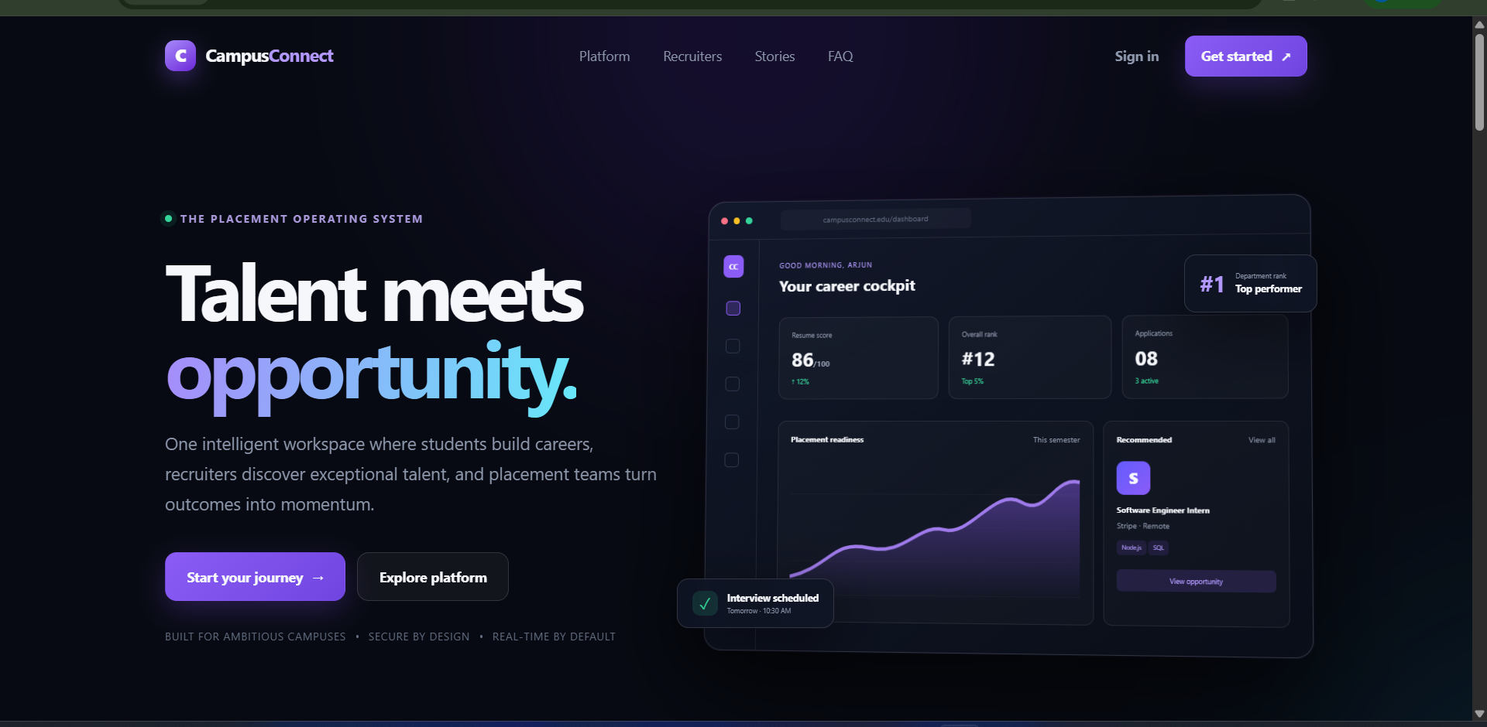
PROBLEM STATEMENT
Current placement workflows are fragmented
• Students often depend on multiple channels to discover opportunities and track applications.
• Recruiters need a structured way to publish roles and manage applicants.
• Placement teams require centralized approval, monitoring, analytics and reporting.
• Important updates such as interviews, application status and announcements can be difficult to track consistently.
Goal: bring students, recruiters and placement teams into one web platform.
Project Review
Department of Computer Science and Engineering
2

Slide 3
PROJECT OBJECTIVES
1. Build an interactive web application
2. Support three user roles
3. Apply Web Programming concepts
Create a responsive interface using HTML5, CSS3 and vanilla JavaScript.
Provide dedicated experiences for students, recruiters and placement officers.
Use forms, DOM manipulation, events, validation, responsive CSS and API-driven updates.
4. Centralize placement workflows
5. Demonstrate a complete system
Manage opportunities, applications, interviews, profiles and announcements.
Connect the frontend to Node.js/Express APIs and MySQL for real application behavior.
Project Review
Department of Computer Science and Engineering
3

Slide 4
ABSTRACT
CampusConnect is a full-stack web application designed to centralize college internship and placement activities. The platform provides role-based interfaces for students, recruiters and placement officers. The frontend is built with HTML, CSS and vanilla JavaScript, while the backend uses Node.js and Express.js with MySQL for data management.
The application supports opportunity discovery, applications, interview scheduling, profiles, approvals, rankings, reports, notifications and real-time student–recruiter communication.
STUDENT
Profile • Opportunities • Applications • Interviews • Ranking
RECRUITER
Company profile • Job posts • Applicants • Interviews • Chat
PLACEMENT OFFICER
Approvals • Users • Analytics • Reports • Governance
Project Review
Department of Computer Science and Engineering
4

Slide 5
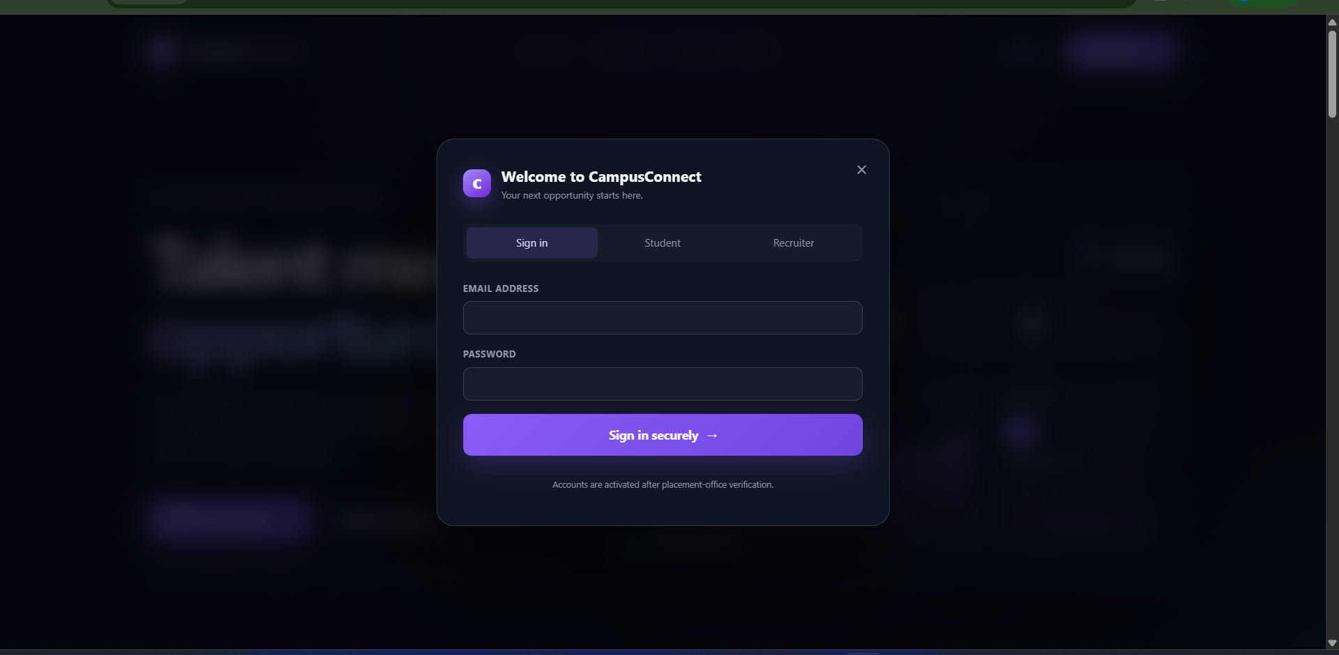
HTML & CSS IMPLEMENTATION
HTML5 provides the structure
• Semantic sections: nav, main, section, article, footer
• Forms for login, registration, contact and profile workflows
• Buttons, inputs, selects, tables, lists and dynamic containers
• Accessibility attributes such as labels, aria-label and required fields
HTML FORM EXAMPLE
<form id="login-form" class="auth-form">
<label>Email address
<input type="email" name="email" required>
</label>
<button class="btn primary" type="submit">
Sign in securely
</button>
</form>
CSS3: Flexbox/Grid • responsive breakpoints • hover states • gradients • glassmorphism
The stylesheet defines reusable buttons, cards, panels, dashboards and responsive layouts. Media queries adapt the interface for smaller screens.
Project Review
Department of Computer Science and Engineering
5

Slide 6
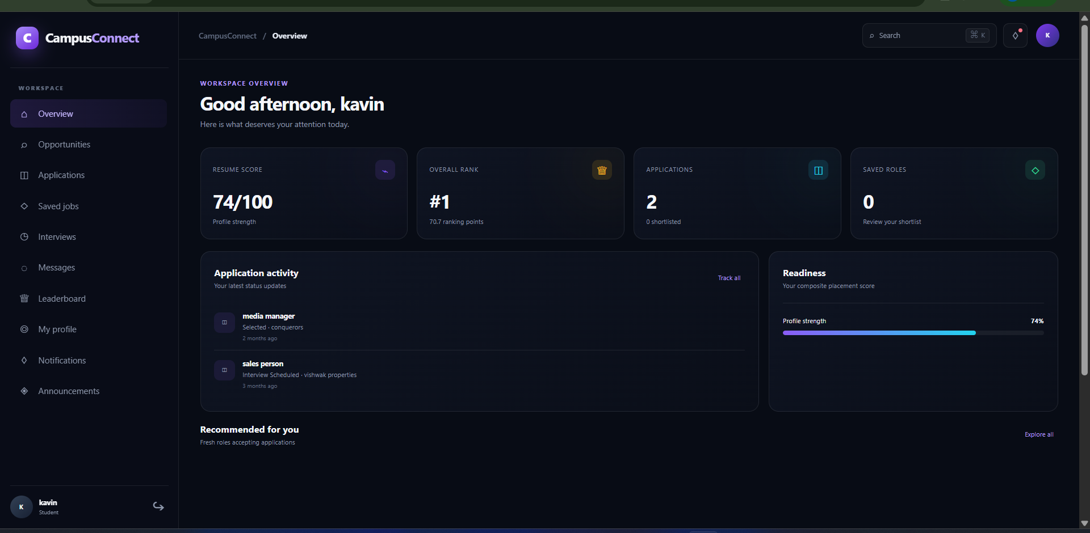
JAVASCRIPT – DOM, EVENTS & DYNAMIC UI
Client-side interaction in CampusConnect
• Event listeners handle click, change, submit and keyboard interactions.
• DOM updates render dashboards, tables, notifications and modal forms dynamically.
• FormData and fetch() connect user actions to backend APIs.
JAVASCRIPT EVENT + API EXAMPLE
document.addEventListener('submit', async (event) => {
const form = event.target;
event.preventDefault();
const result = await api('/profile', {
method: 'PUT',
body: Object.fromEntries(new FormData(form))
});
toast(result.message);
});
Project Review
Department of Computer Science and Engineering
6

Slide 7
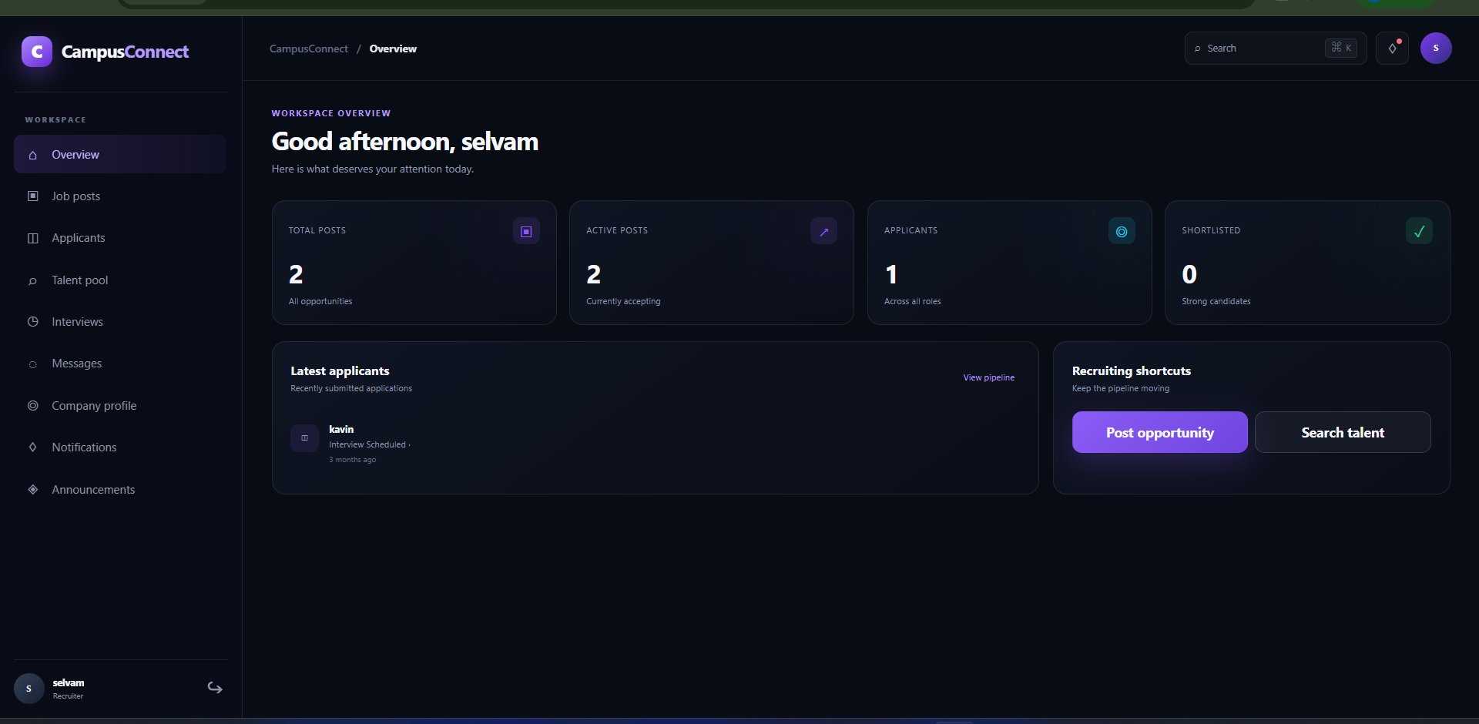
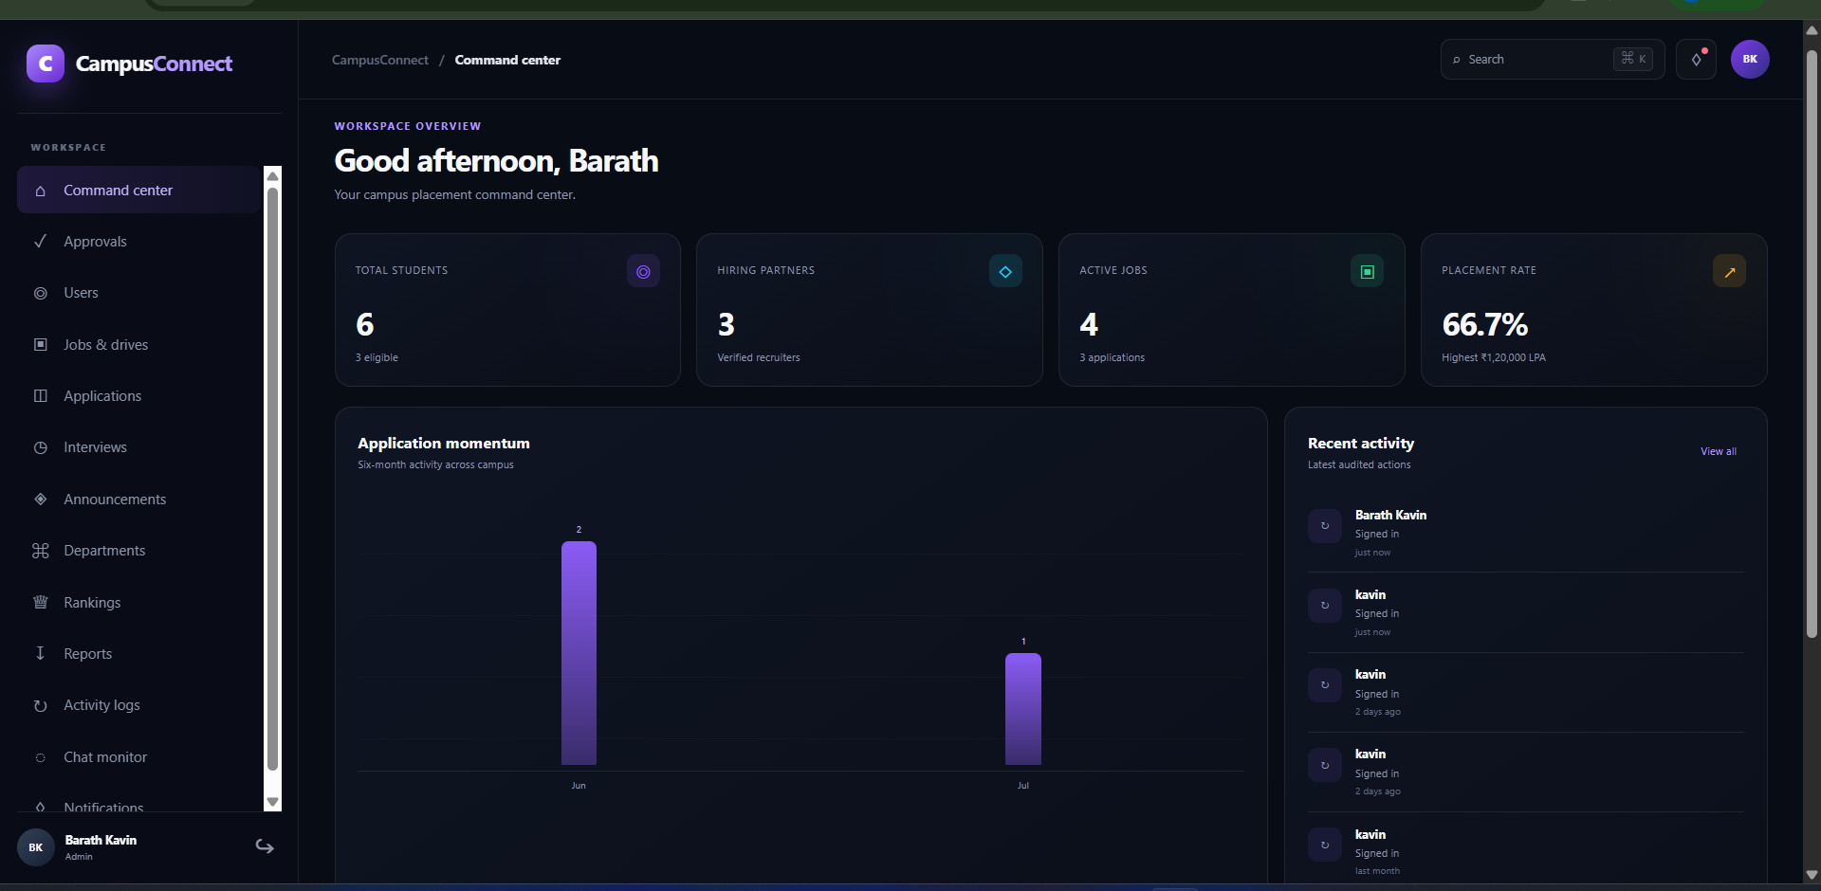
USER MODULES & INTERFACES
STUDENT PORTAL
RECRUITER PORTAL
ADMIN / PLACEMENT OFFICER
Opportunities • Applications • Saved jobs • Interviews • Profile • Ranking
Job posts • Applicants • Talent pool • Interviews • Company profile
Approvals • Users • Jobs • Analytics • Reports • Activity logs
Project Review
Department of Computer Science and Engineering
7

Slide 8
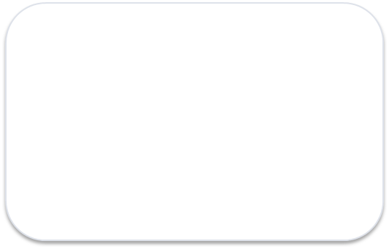
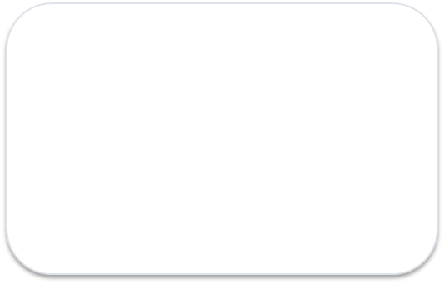
METHODOLOGY
How the web application works
1
2
3
User Interface
Communication
Interaction
HTML + CSS
JavaScript + DOM + Events
fetch() + REST API
6
5
4
Real-time
Data Layer
Server Logic
Socket.IO
MySQL
Node.js + Express.js
Development approach: design the interface → implement client-side behavior → connect APIs → persist data → add role-based and real-time features → test the complete flow.
Project Review
Department of Computer Science and Engineering
8

Slide 9
SYSTEM ARCHITECTURE
CLIENT / FRONTEND
HTML5 • CSS3 • Vanilla JavaScript
APPLICATION / API
Node.js • Express.js • REST endpoints
DATA / SECURITY
MySQL • JWT • bcryptjs
REAL-TIME / FILES
Socket.IO • PDF uploads • protected downloads
Role-based access: Student | Recruiter | Placement Officer / Admin
Project Review
Department of Computer Science and Engineering
9

Slide 10
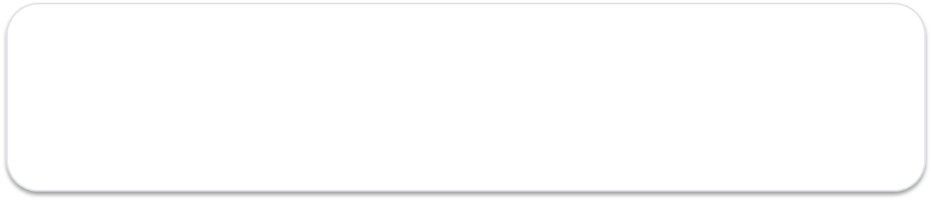
TECHNOLOGIES USED
HTML5
Page structure & forms
MySQL
Persistent data storage
CSS3
Responsive UI & visual design
JWT + bcryptjs
Authentication & password security
JavaScript
DOM, events, validation & API calls
Socket.IO
Real-time chat & updates
Node.js + Express
Server & REST API
GitHub + Ubuntu + PM2
Version control & deployment
Live deployment: CampusConnect is running as a working web application on an Ubuntu server.
http://76.13.243.90:3103
Project Review
Department of Computer Science and Engineering
10

Slide 11
CAMPUSCONNECT – WEB PROGRAMMING PROJECT
Live demo: http://76.13.243.90:3103
Barath Kavin S | 240701071
CS23531 – Web Programming
THANK YOU
Project Review
Department of Computer Science and Engineering
11

